Slide 1
Interface blueprint of NN Model Simulator

Slide 2
Plan for Interface
Build
Simulate
Data
Train
Extract
Export
Load Data

Slide 3
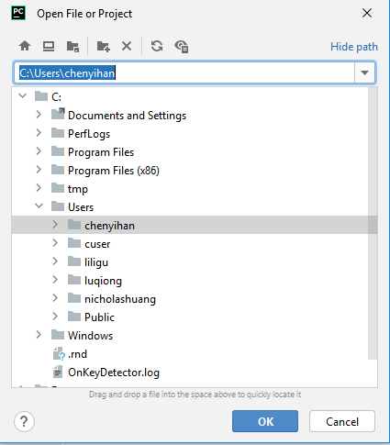
Plan for Interface
Build
Simulate
Data
Load Data
Train
Extract
Window pop after click
Export
Load Data

Slide 4
Plan for Interface
Build
Simulate
Data
Load Data
File “xxx.txt” loaded successfully !
variables
Train
Vg
Extract
Vd
Export
Id
Load Data
gm
…
New plot
X-axis
Y-axis

Slide 5
Plan for Interface
Build
Simulate
Data
Load Script
Save Script
Start training
Train
Extract
Export
Load Data
Type the script here or load a local one

Slide 6
Plan for Interface
Build
Simulate
Data
Load Script
Save Script
Start training
Train
Extract
Export
Load Data
Show the “warning”, “error”, “print” messaga here

Slide 7
Plan for Interface
Build
Simulate
Data
Load Script
Save Script
Start training
Train
Extract
Export
Load Data
Wow, Training is completed !

Slide 8
Plan for Interface
Build
Simulate
Data
Export to Verilog-a file
Train
Path:
…
Extract
Export
File Name:
Load Data
Export

Slide 10
New project
load project
Save project
save project as
File
Load Data
出弹窗
Plot Data
Extract
Simulate

